Slide 1
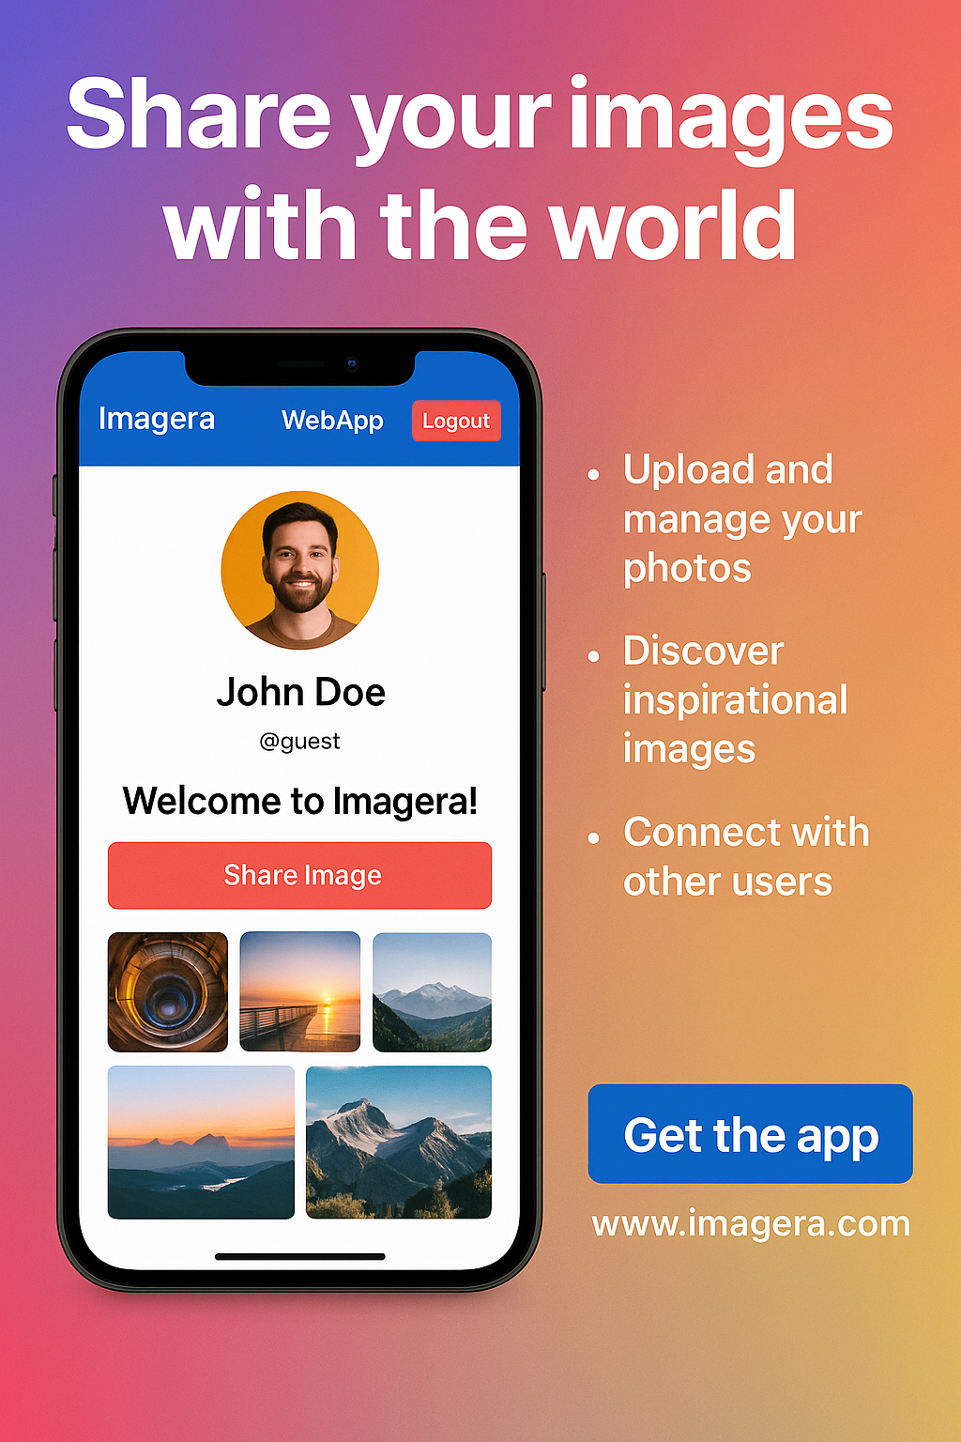

A Project Report On
Imagera – A Modern Image Sharing Web-Application
A Creative Platform for Uploading, Saving
& Discovering Images
GROUP MEMBERS:
CHAUHAN HITARTH (EXAM NO: ---)
SAVLANI DHIREN (EXAM NO: ---)
PROJECT GUIDE:
RASHMIKABEN MEMON

Slide 2
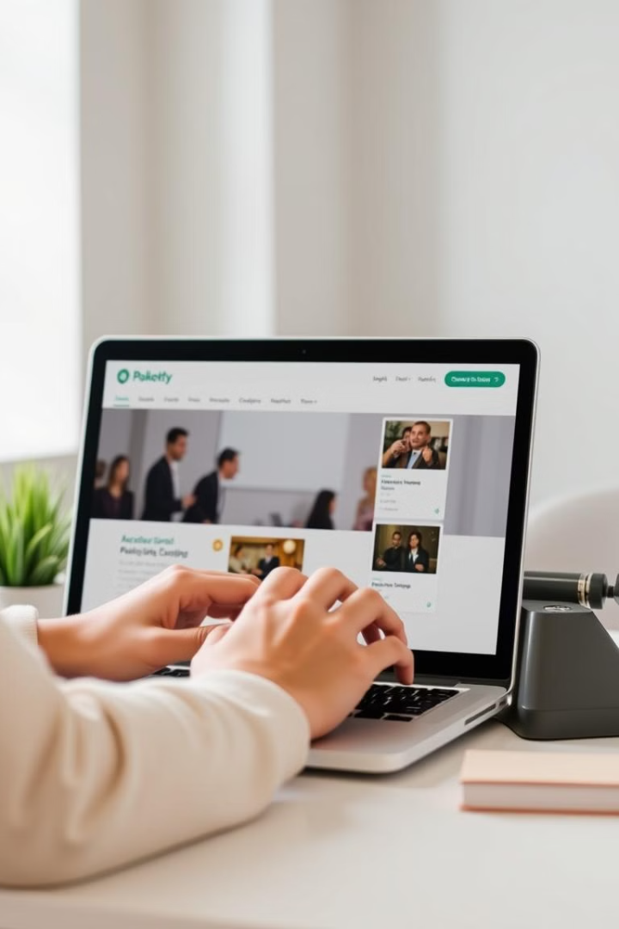
Introduction
Imagera is a modern, web-based image sharing platform that allow users to upload, explore ans save visual content across various categories. Designed with a user-friendly interface and real-time responsiveness, Imagera enables users to express creativity and discover inspiration from others in a seamless and interactive environment.
Image Sharing
Upload High-Quality images with titles, description and categories.
Save and Like Pins
Easily Save and like pins you enjoy to revisit them later.
Commenting System
Engage with posts through direct comments & feedback.
Responsive & Dark Mode Support
Access your content anywhere with mobile-friendly layout and dark-mode support.

Slide 3
Objectives
Build a user-friendly image sharing platform
Allow users to upload, save, like and interact with pins
Enable image discovery via categories and search
Support user engagement through comments and likes
Designed for responsiveness and dark mode
Ensure Scalability for future enhancements like admin dashboard and rewards
Earn Rewards through virtual coins

Slide 4
Problem Statement
Traditional Challange
Imagera’s Solution
Lack of category-wise filtering and organization
Imagera addresses these challenges by offering a user-friendly, category-based image sharing platform with real-time functionality.
Limites user engagement in traditional gallery systems
No real-time interaction like commenting, saving, or dark-mode
Allows users to upload, explore, save, like and comment on pins in a dynamic layout
No admin oversight or content moderation system
Admin tools and future enhancements ensure content quality and growth

Slide 5



Target Users
Admin
General Users (Creator & Viewer)
Review and moderate uploaded pins
Upload, save and browes image pins
Remove inappropriate content
Filter content by category
Manage users through admin panel
Switch between light/dark mode for a personalized experience
Handle coins/redeem requests
Like & Commenting on pins
Earn coins through likes on their post

Slide 6





Technologies Used & Benefits
Technologies
Benefits of Imagera
React.js Frontend
Modern and clean user interface
Tailwind Css Styling
Fast and responsive performance
Cloud-based content management with real-time updates
Sanity.io Backend CMS
Dark/light theme switching
Easily Scalable for future features (e.g. Modern Dashboard, Collection)
Secure User Authentication

Slide 7

Key Features
Pin Upload Users can upload images (pins) with titles, categories, and descriptions.
Category Filtering Pins are organized and filtered by categories for easier discovery.
Save & Like Pins Users can save and like posts they enjoy for quick access later.
Commenting System Interactive commenting allows engagement on each pin.
Reward System Earn coins through like earned on post
Dark Mode & Responsive UI Switch between light/dark themes; fully optimized for mobile and desktop.

Slide 8
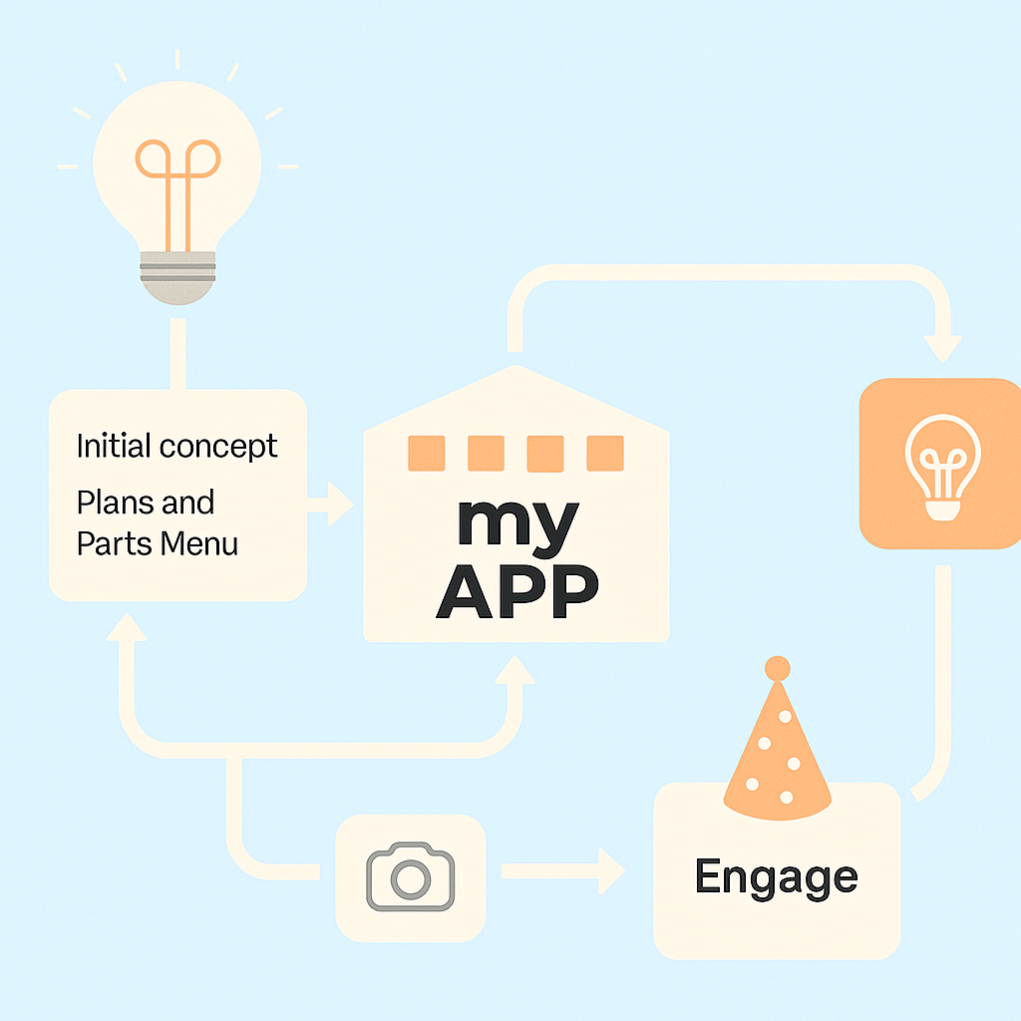
Workflow of Imagera
User Process Flow
1. User Signs in with Google 2. Browses or Searches pins by category 3. Uploads new pins with title, image & description 4. Saves and like pins they like 5. Comments on other’s posts 6. Request for redeem coins they earned
1
Admin Process Flow
1. Reviews User posted pins 2. Manage pins posted by users 3. Manage Users 4. Remove Inappropriate content 5. Manage Redeem-Requests
2

Slide 9
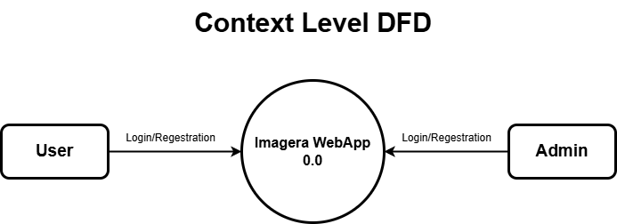
DFD(DATA FLOW DIAGRAM)
CONTEXT LEVEL DIAGRAM :

Slide 10
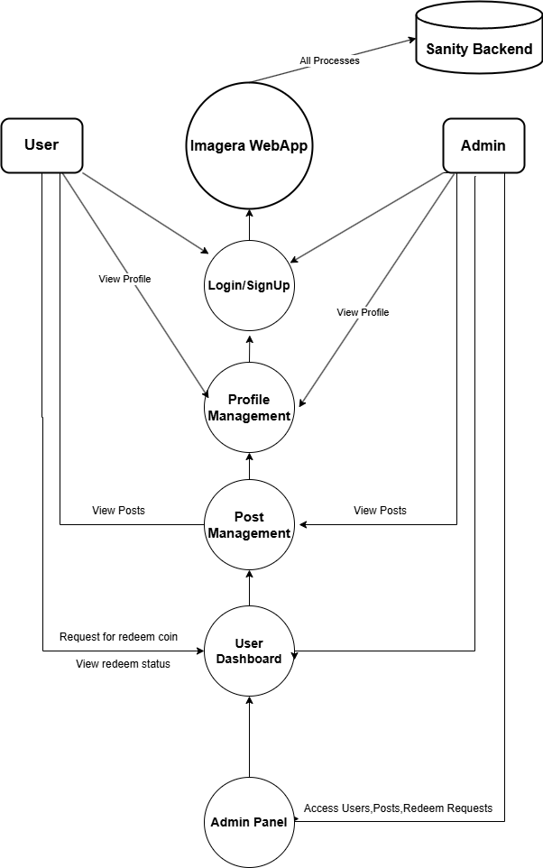
DFD(DATA FLOW DIAGRAM)
FIRST LEVEL DFD:

Slide 11
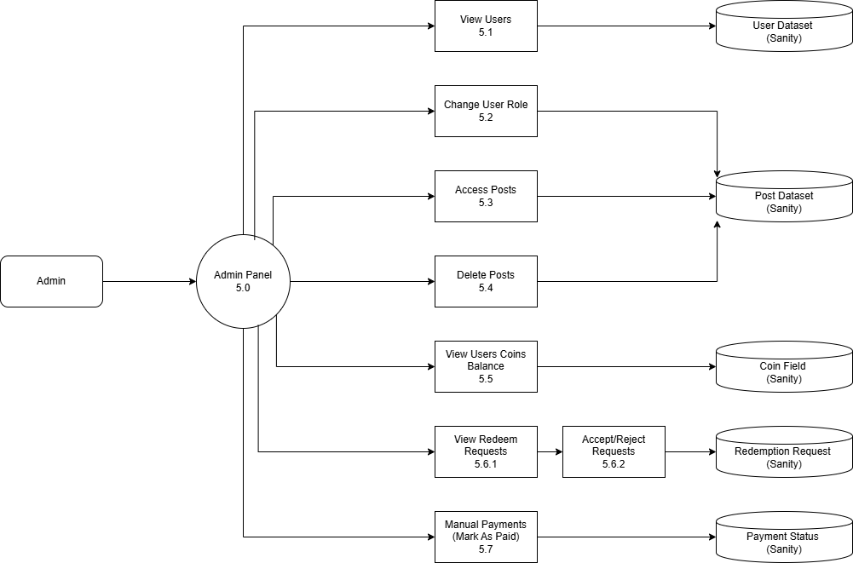
DFD(DATA FLOW DIAGRAM)
SECOND LEVEL DFD(ADMIN SIDE):

Slide 12
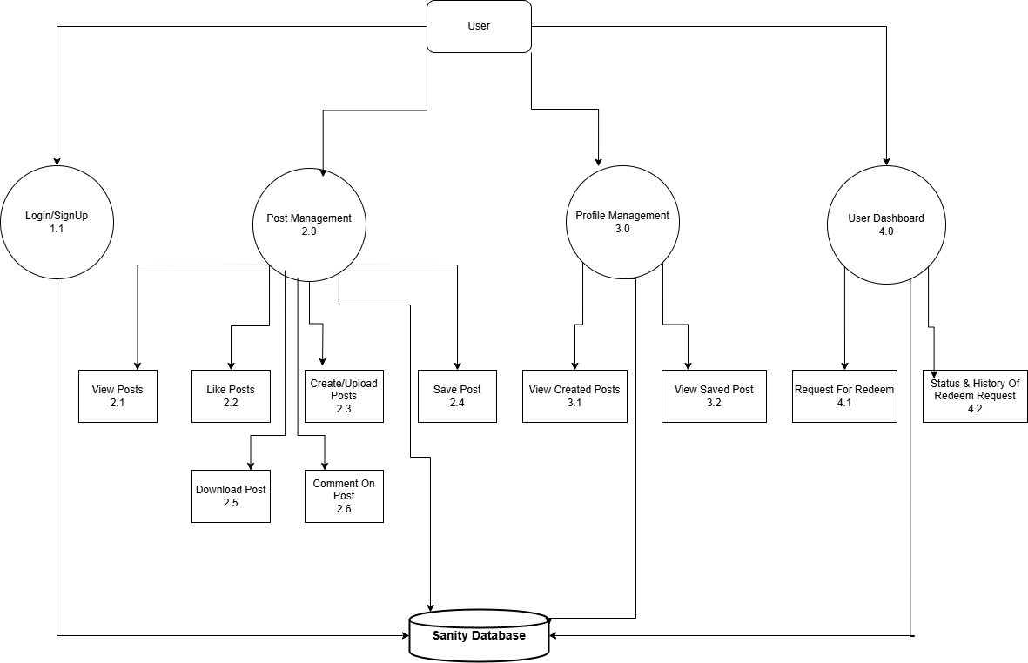
DFD(DATA FLOW DIAGRAM)
SECOND LEVEL DFD(USER SIDE):

Slide 13
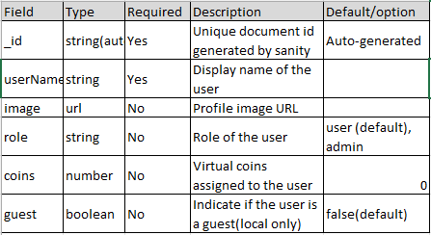
DATA DICTONARY
1. DOCUMENT : USER

Slide 14
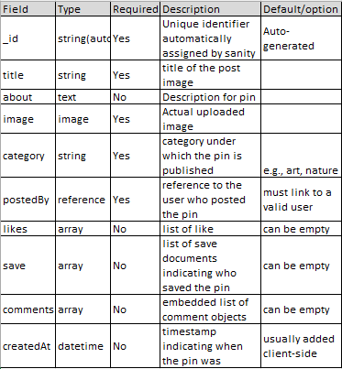
DATA DICTONARY
2. DOCUMENT : PIN

Slide 15
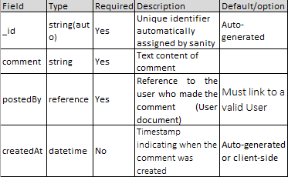
DATA DICTONARY
3. DOCUMENT : COMMENT

Slide 16
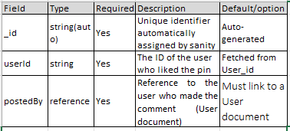
DATA DICTONARY
4. DOCUMENT : LIKE

Slide 17
DATA DICTONARY
5. DOCUMENT : SAVE

Slide 18
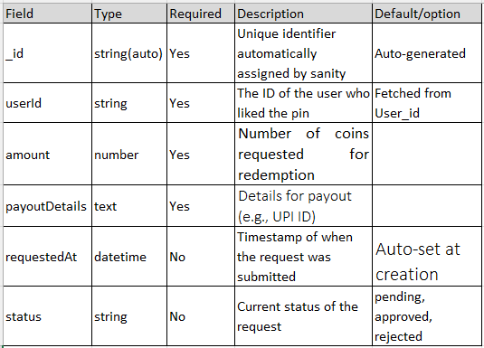
DATA DICTONARY
6. DOCUMENT : REDEEMREQUEST

Slide 19
OUTPUT DESIGN
IMAGERA ADMIN :

Slide 20
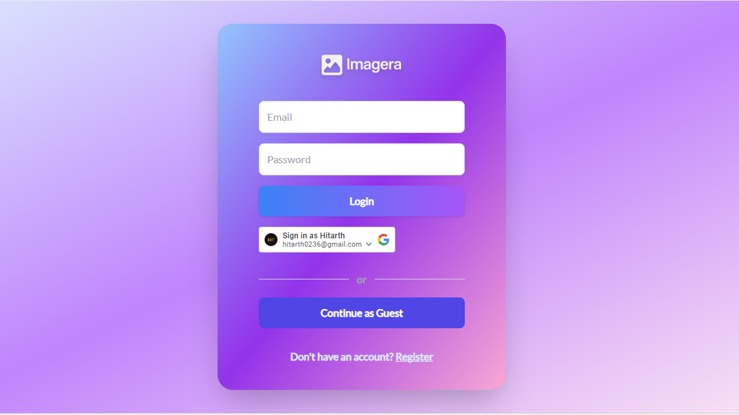
OUTPUT DESIGN
IMAGERA ADMIN :
LOGIN PAGE :

Slide 21
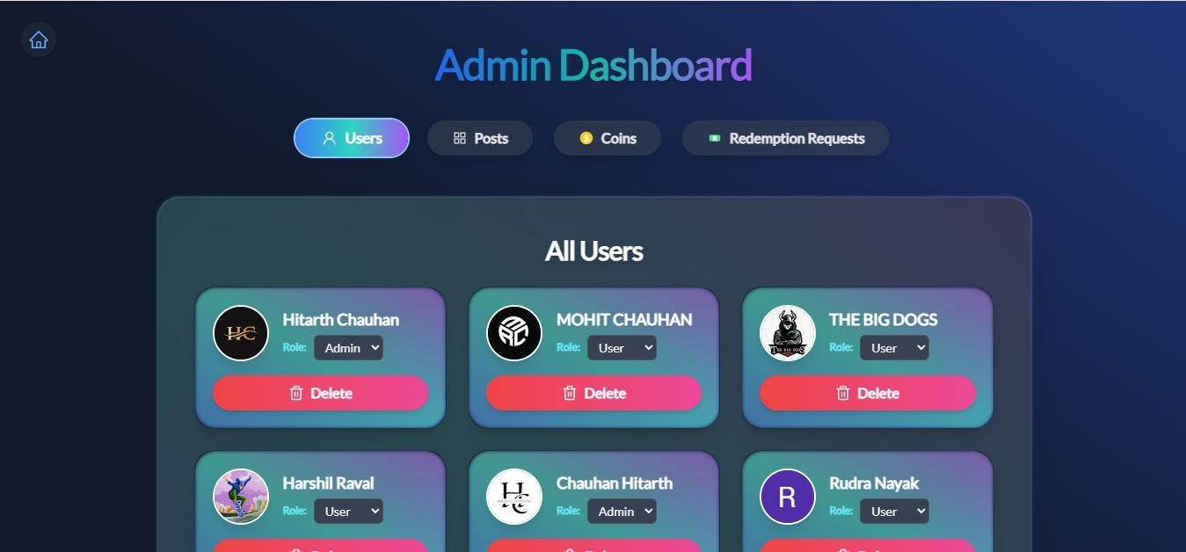
OUTPUT DESIGN
IMAGERA ADMIN :
DASHBOARD OVERVIEW :

Slide 22
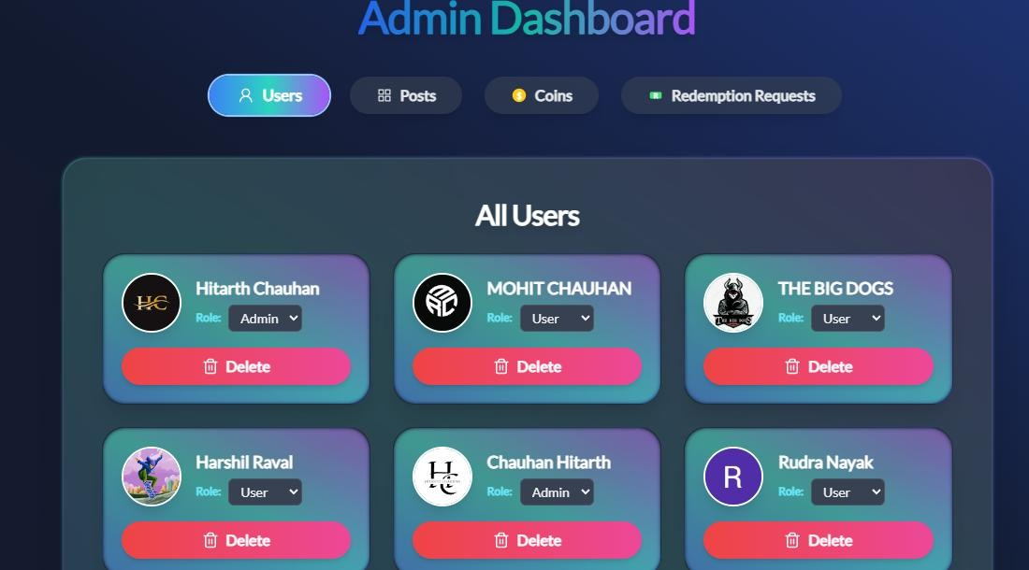
OUTPUT DESIGN
IMAGERA ADMIN :
MANAGE USERS :

Slide 23
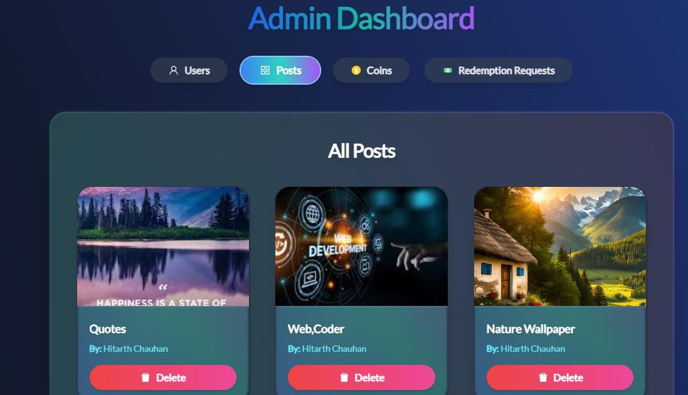
OUTPUT DESIGN
IMAGERA ADMIN :
MANAGE PINS :

Slide 24
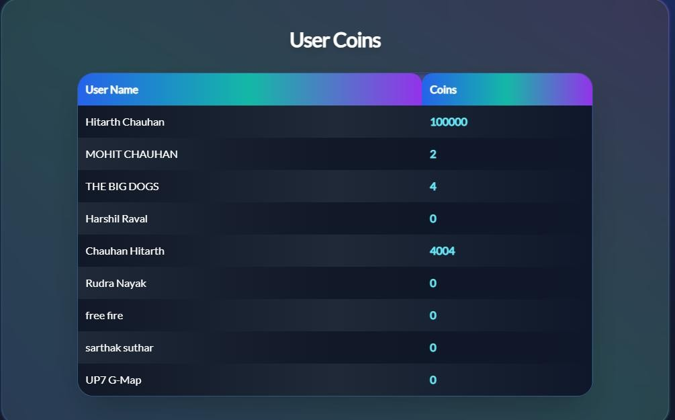
OUTPUT DESIGN
IMAGERA ADMIN :
MANAGE Coins :

Slide 25
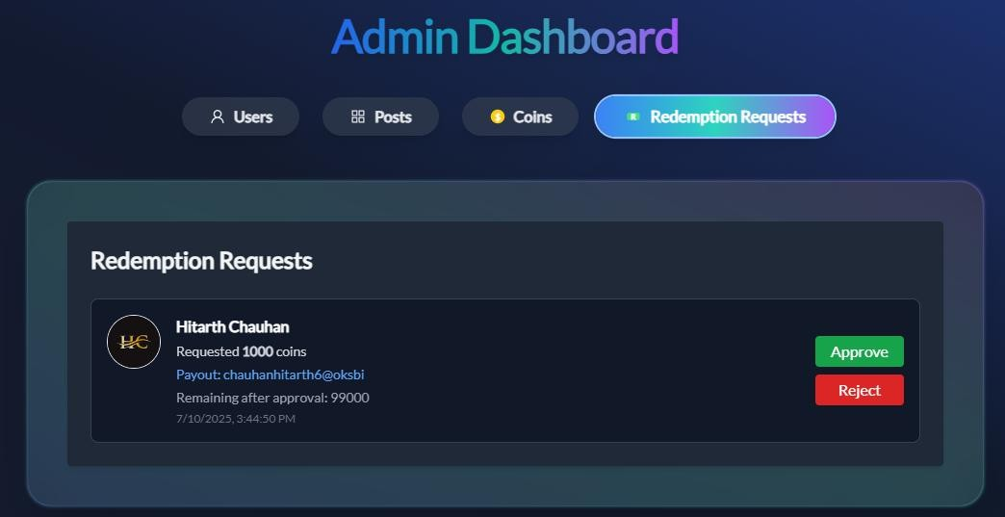
OUTPUT DESIGN
IMAGERA ADMIN :
MANAGE requests :

Slide 26
OUTPUT DESIGN
IMAGERA USER :

Slide 27
OUTPUT DESIGN
IMAGERA USER :
LOGIN PAGE :

Slide 28
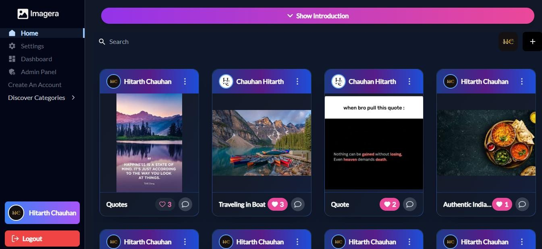
OUTPUT DESIGN
IMAGERA USER :
hOME PAGE :

Slide 29
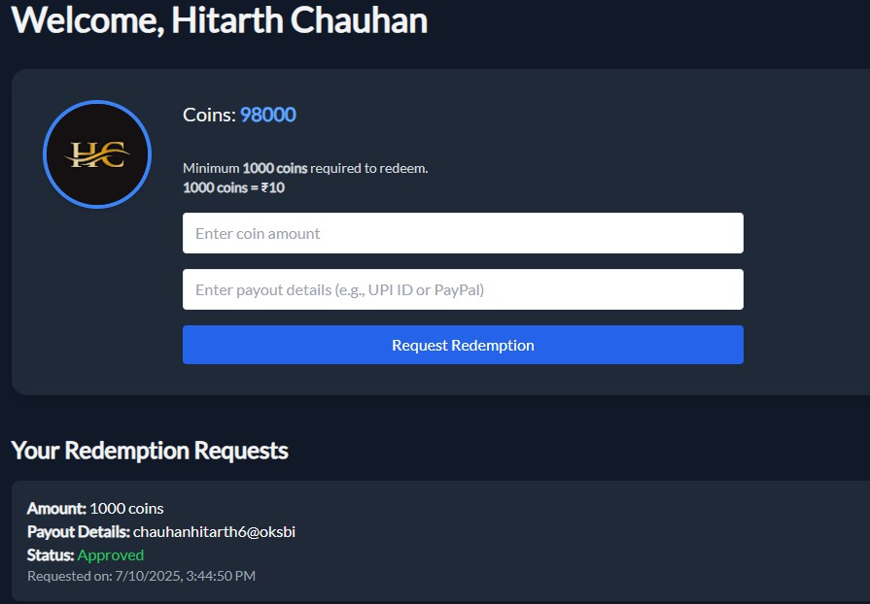
OUTPUT DESIGN
IMAGERA USER :
User dashboard PAGE :

Slide 30
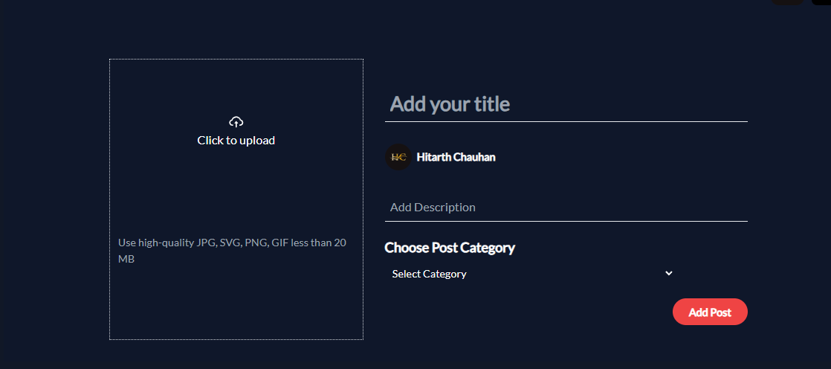
OUTPUT DESIGN
IMAGERA USER :
UPLOAD PAGE :

Slide 31
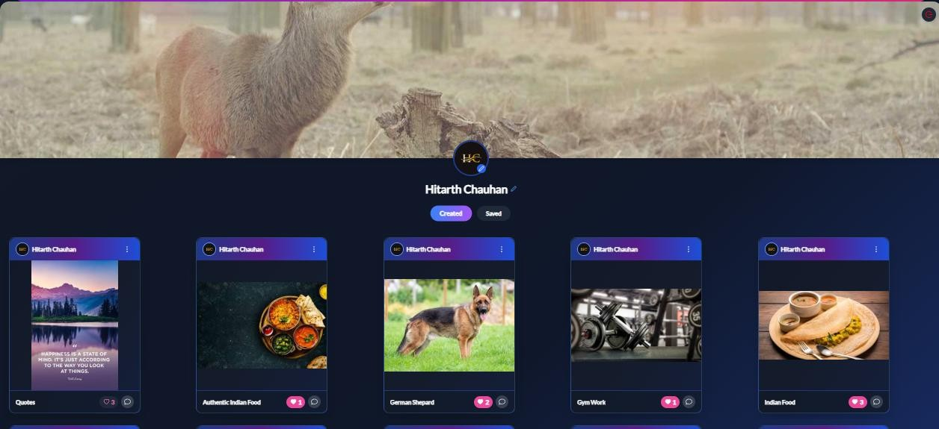
OUTPUT DESIGN
IMAGERA USER :
PROFILE PAGE :

Slide 32
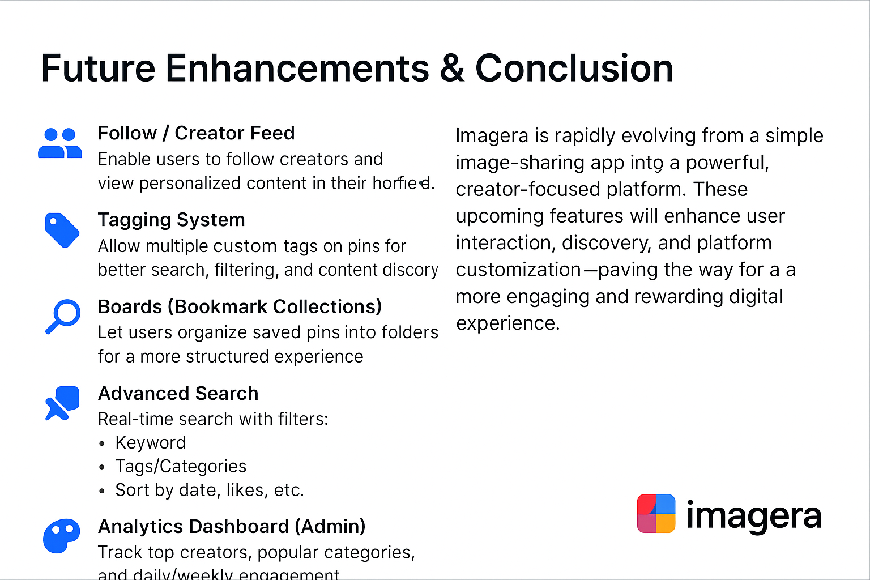

Slide 33


THANK YOU
We extend our sincere gratitude to everyone.
Group Members:
Project Guide:
Chauhan Hitarth (Exam No: ___)
RASHMIKABEN MEMON
Savlani Dhiren (Exam No: ___)
Also appreciation to our knowledgeable project guide.

